Slide 1
Process Measurement
Personal Software ProcessSM for Engineers: Part I

Slide 2
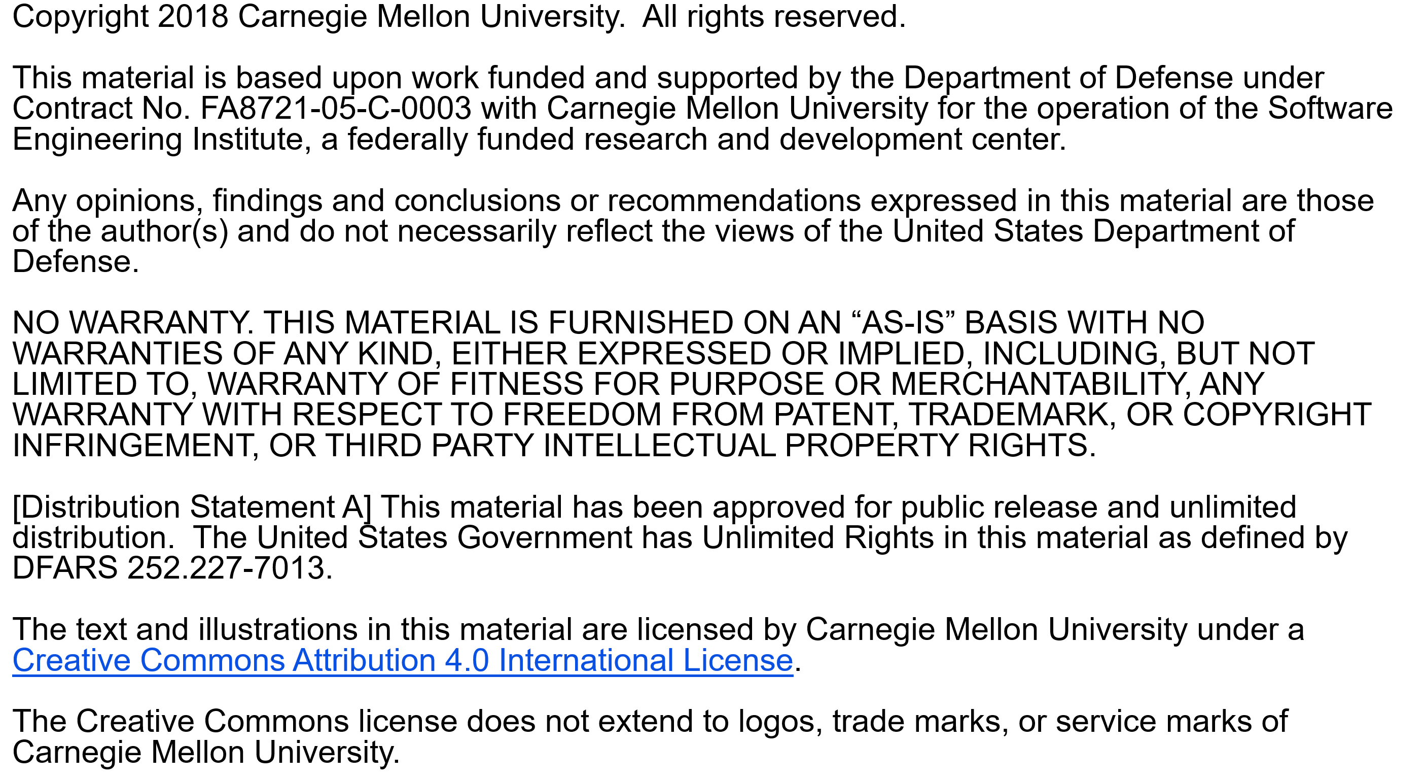

Slide 3
Copyright 2016 Carnegie Mellon University [Distribution Statement A] This material has been approved for public release and unlimited distribution. Please see Copyright notice for non-US Government use and distribution. This material is based upon work funded and supported by the Department of Defense under Contract No. FA8721-05-C-0003 with Carnegie Mellon University for the operation of the Software Engineering Institute, a federally funded research and development center. NO WARRANTY. THIS CARNEGIE MELLON UNIVERSITY AND SOFTWARE ENGINEERING INSTITUTE MATERIAL IS FURNISHED ON AN “AS-IS” BASIS. CARNEGIE MELLON UNIVERSITY MAKES NO WARRANTIES OF ANY KIND, EITHER EXPRESSED OR IMPLIED, AS TO ANY MATTER INCLUDING, BUT NOT LIMITED TO, WARRANTY OF FITNESS FOR PURPOSE OR MERCHANTABILITY, EXCLUSIVITY, OR RESULTS OBTAINED FROM USE OF THE MATERIAL. CARNEGIE MELLON UNIVERSITY DOES NOT MAKE ANY WARRANTY OF ANY KIND WITH RESPECT TO FREEDOM FROM PATENT, TRADEMARK, OR COPYRIGHT INFRINGEMENT. This material is distributed by the Software Engineering Institute (SEI) only to course attendees for their own individual study. Except for the U.S. government purposes described below, this material SHALL NOT be reproduced or used in any other manner without requesting formal permission from the Software Engineering Institute at permission@sei.cmu.edu. The U.S. Government's rights to use, modify, reproduce, release, perform, display, or disclose this material are restricted by the Rights in Technical Data-Noncommercial Items clauses (DFAR 252-227.7013 and DFAR 252-227.7013 Alternate I) contained in the above identified contract. Any reproduction of this material or portions thereof marked with this legend must also reproduce the disclaimers contained on this slide. Although the rights granted by contract do not require course attendance to use this material for U.S. Government purposes, the SEI recommends attendance to ensure proper understanding. Carnegie Mellon® is registered in the U.S. Patent and Trademark Office by Carnegie Mellon University. Personal Software ProcessSM, PSPSM, Team Software ProcessSM and TSPSM are service marks of Carnegie Mellon University. DM-0004310

Slide 4
Lecture Topics
Process measurement
Software size
why measure size
size measurement criteria
the SEI size measurement framework
Counting program size
size counters
coding standards

Slide 5
Process Measurement Principles
To be useful, measurements should be
gathered for a specific purpose
explicitly defined
properly managed
properly used
Measuring your process will not improve it. You must make process changes to achieve lasting improvement.

Slide 6
Process Measurement Purposes
We measure to
understand and manage change
predict or plan for the future
compare one product, process, or organization with another
determine adherence to standards
provide a basis for control

Slide 7
Measurement Objectives
Measurements only produce numbers.
To be useful, they must
relate to business objectives
be properly interpreted
lead to appropriate action
If the business purposes for the measurements are not understood
the wrong data may be gathered
data may not be properly used

Slide 8
Types of Measurements
We generally need objective and explicit measures.
To be useful, we need relationships that correlate.
program size versus development hours
cost distributions
defect densities
We also seek a controlling or predictive capability.
actions to reduce test defects
steps to improve review quality
means to improve productivity

Slide 9
The PSP Measurements
The basic PSP data are
program size
time spent by phase
defects found and injected by phase
Both actual and estimated data are gathered on every item.
Measures derived from these data
support planning
characterize process quality

Slide 10
PSP Size Measures
The goals of the PSP size measures are to
define a consistent size measure
establish a basis for normalizing time and defect data
help make better size estimates
Some of the questions these data can help to answer are
What size program did I plan to develop?
How good was my size estimate?
What was the completed size of the finished program?

Slide 11
PSP Time Measures
The goals of the PSP time measures are to
determine how much time you spend in each PSP phase
help you to make better time estimates
Typical questions these data can help answer are
How much time did I spend by PSP phase?
How much time did I plan to spend by PSP phase?

Slide 12
PSP Defect Measures
The goals of the PSP defect measures are to
provide a historical baseline of defect data
understand the numbers and types of defects injected
understand the relative costs of removing defects in each PSP phase
Some questions these data can help answer are
How many defects did I make in each phase?
How many defects did I remove in each phase?
How much time did it take to find and fix each defect?

Slide 13
PSP Derived Measures
Some PSP derived measures are
To Date and To Date %
Product size developed or reviewed per hour
CPI
% Reuse and % New Reusable
A/FR
PQI
You will learn about these measures in the rest of the PSP course.

Slide 14
Size Measurement Criteria
Size measurements must be
related to development effort
precise
machine countable
suitable for early planning

Slide 15
Size Versus Development Effort
The principal requirement: If the size measure is not directly related to development cost, it is not worth using.
There are many possible measures.
database elements
lines of code (LOC)
function points
pages, screens, scripts, reports
The size measure should be sensitive to language, design, and development practice.

Slide 16
Text Pages Versus Time

Slide 17
Script Size Versus Time

Slide 18
Report Size Versus Time

Slide 19
Screen Elements Versus Time

Slide 20
C++ LOC Versus Time

Slide 21
Pascal LOC Versus Time

Slide 22
Relationship to Development
Pages are often an acceptable measure for document development.
LOC is usually a good measure for developing source programs like Pascal and C++.
Other possible measures are function points, screens, modules, database elements, and maintenance fixes.

Slide 23
Precision and Accuracy

Slide 24
Measurement Precision
When two people measure the same thing, will they get the same result?
To do so requires a precise measurement definition.
The measure must also be properly applied.
Different people will likely have different definitions of database elements.
Pascal LOC do not equate to assembler LOC.
New LOC are not the same as modified LOC.
Logical LOC do not equate to physical LOC.
One person’s C++ LOC may not relate to someone else’s C++ LOC.

Slide 25
Machine Countable
Manual size counting is time-consuming and inaccurate.
Automated counters will only work for defined product characteristics.
Counters can be complex, depending on the
size definition selected
counting method used

Slide 26
Suitable for Early Planning -1
For making initial project plans, measures are needed that you can visualize at the beginning of the job.
For a house, square feet predicts cost.
Few people can visualize a house in terms of square feet of living space.
Numbers of rooms is more intuitive.
Intuitive size measures are usually needed for initial plans.

Slide 27
Suitable for Early Planning -2
Unfortunately, popular intuitive measures are not often measurable, and popular measurable measures are often not intuitive.
Function points
intuitive
not directly measurable
LOC
not intuitive
directly measurable

Slide 28
Selecting a Size Measure -1
Start with product development data.
resources required
product characteristic measures
any special development conditions
Rank products by resources required.
See what characteristics distinguish those products that took the greatest effort from those that took the least.

Slide 29
Selecting a Size Measure -2
See if these differences are measurable.
Correlate a selected measure for the product set.
If there is no correlation, try again.
There may be no single best measure.
A combination of measures could be needed.
Methods for handling multiple measures are discussed later.

Slide 30
Selecting a Size Measure -3
If you are better at estimating resources than program size, size estimation will not improve your planning.
If you estimate resources directly, you must
keep accurate records
build a large database
use an estimating guru

Slide 31
LOC Measurement
The suggested PSP LOC measure uses logical (versus physical) lines of code.
Statement specifications
executable
nonexecutable
counted statement types
Application
language and code type
origin and usage

Slide 32
Counting Program Size -1
Logical lines
invariant to editing changes
correlate with development effort
uniquely definable
complex to count
Physical lines
are easy to count
are not invariant
must be precisely defined for each case

Slide 33
Counting Program Size -2
The PSP uses a coding standard and a physical counter for LOC size measures.
defined coding standard
physical line for each logical line
This standard must be faithfully followed.
Then, physical line counting equals logical line counting.

Slide 34
A LOC Counting Example
procedure ISet.Set(var N: int; var inc: boolean);
begin
inc := false;
SearchPtr := SetStart;
while (SearchPtr<>nil) and (inc == false) do
if SearchPtr^.ThisN == N
then
inc := true
else
SearchPtr:=SearchPtr^.NextN;
end;

Slide 35
PSP’s LOC Counting Standard
Count all statements. This includes
begin, end, if, then, else,
{, }, ;, .,
declarations, directives, headers, etc.
Do not count blanks, comment lines, or automatically generated code.
Count added and modified code for measuring and estimating development productivity.

Slide 36
Size Accounting
For small products, size tracking can be done manually, but it requires care.
For larger products, size tracking requires an accounting system.
Size accounting provides an orderly and precise way of tracking size changes through multiple product versions.

Slide 37
Example of Size Accounting -1
What happened?

Slide 38
Example of Size Accounting -2
 | Added | Subtracted | Base
Base V0 |  |  | 0
Deleted |  | 0
Modified | 0 | 0
Added | 350
Base V1 | 350 | -0 | 350
Deleted |  | 0
Modified | 25 | 25
Added | 100
V1 Product | 125 | -25 | 450
Total Added and Modified LOC |  |  | 475

Slide 39
Messages to Remember
To effectively plan and manage your work, you must measure product size.
For different types of work, use different size measures.
For each measure, size must correlate with development time.
If the size measure does not correlate or is not automatically countable, it will not be very useful.
Every size measure should be precisely defined and automatically countable.

